Slide 1
DSO-547: Spreadsheet-Based Business Modeling
5. Integer Programming
Hiroshi Ochiumi

Slide 2
Optimization Models
Linear Programming (LP) Models
Both objective and constraints are linear functions of the decision variables.
Integer Programming (IP) Models
Objective and constraints are linear;
Some variables must take integer values;
Two types: integer linear programming, and integer nonlinear programming
Non-linear Programming (NP) Models
Either objective or constraints are non-linear.

Slide 3
Solver Behavior
LP Models: Always find an optimal solution
ILP Models: May take a long time to find an optimal solution
NP & INP Models: Cannot find an optimal solution in general
Whenever possible, model as LP.

Slide 4
Two Types of Integer Linear Programming Models
Some ILP models are simply LP models with certain variables constrained to be integers
Building such an ILP model requires just a couple of additional steps beyond an LP model
Some LP models generate integer solutions, e.g. transportation models and assignment models
Other ILP models (especially with binary variables) can achieve more than LP models can do, but require other modeling techniques

Slide 5
Sensitivity Analysis for Integer Linear Programs
Shadow prices, allowable ranges and reduced costs are meaningless for ILPs.
Sensitivity analysis must be performed manually by changing parameters and re-solving the model.

Slide 6
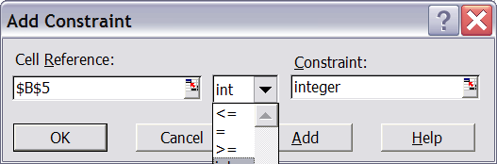
Solver Setup
Solver constraints window allows choices of int and bin for any variable
int: variable must be an integer
bin: variable must be binary, i.e, 0 or 1

Slide 7
Solver Setup
Solver Tolerance parameter is set at 5% (away from true optimum) initially
Allows for fast solutions
Used during debugging, or
For solving large problems
Set close to 0 after debugging, or for smaller problems

Slide 8
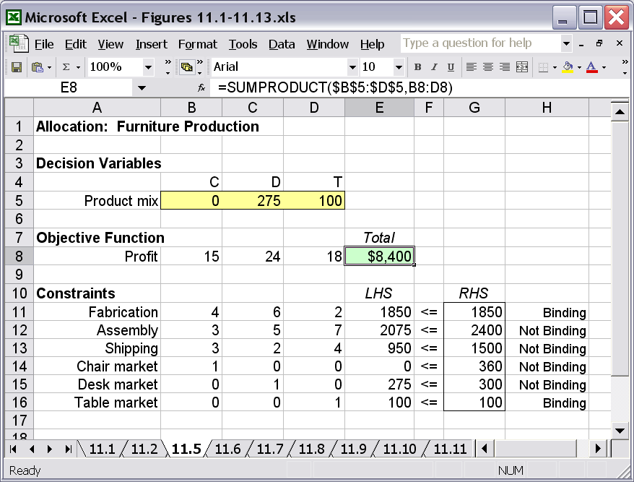
An LP Model with Integer Solution

Slide 9
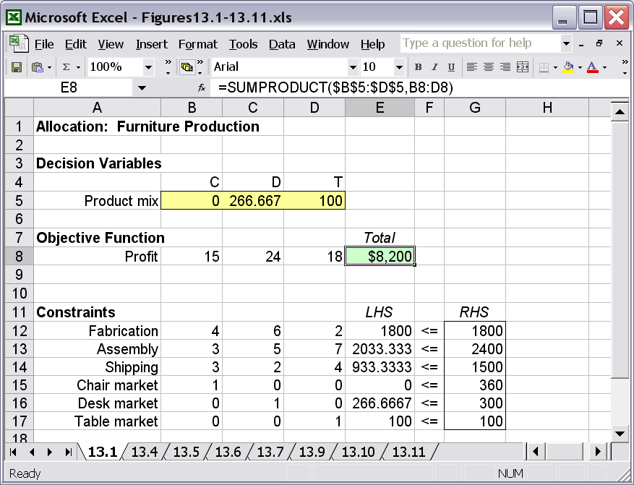
A Slightly Different LP with Non-integer Solution

Slide 10
Situations where Integer Constraints are Unimportant
Cases when fractional values are sufficient (LP is valid):
266.67 desks can be rounded to 266
It can be interpreted as average production quantity
Situations integer values are necessary:
Airplane production
Project selection

Slide 11
Example when Round-up Doesn’t Work: (Queen City Inc.)
Two machines: TopLathe, BigPress
At least 5 machines per month
Component requirements and profits:
Components available: 49
TopLathe BigPress
Components 10 7
Profits $50,000 $34,000

Slide 12
Mathematical Model
Maximize 50,000x₁ + 34,000x₂
Subject to
10x₁ + 7x₂ ≤ 49
x₁ + x₂ ≥ 5
x₁, x₂ ≥ 0 and integer

Slide 13
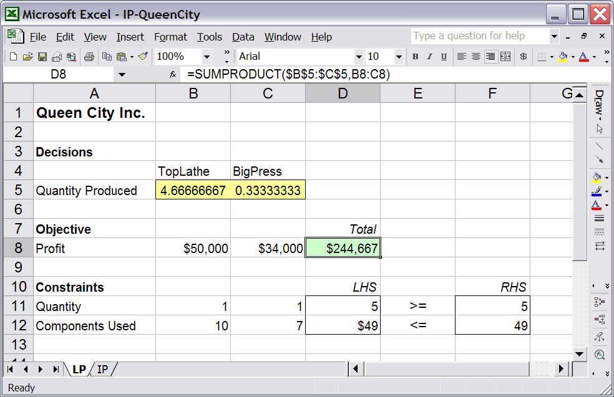
Excel Model: LP Relaxation

Slide 14
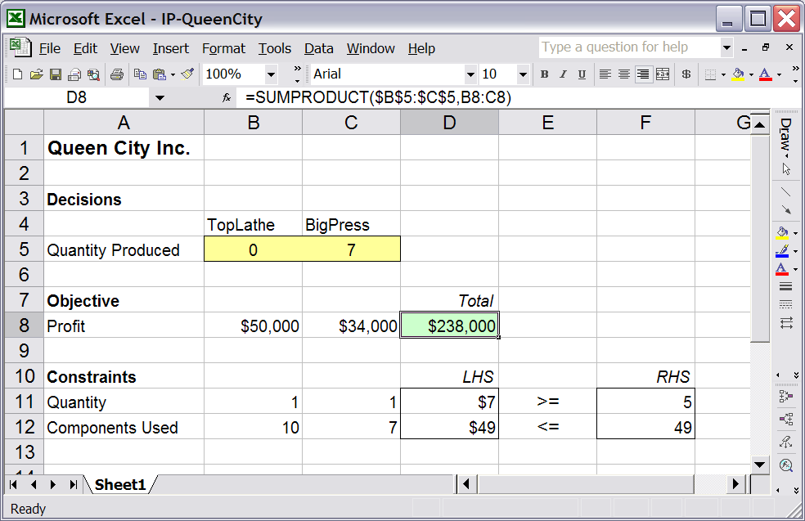
Excel Model: IP

Slide 15
Binary Variables
All or nothing variables (0 or 1)
Represent go/no-go decisions
PROJ_{i} = Indicator for Project i =
Can use to represent structural or policy relationships
Select at least m of the possible projects
Select at most n of the possible projects
Other logical relationships
1, accept i
0, reject i

Slide 16
Example: Project Selection
Capital budgeting (p. 312) at The Marr Corporation
$160m budget for five possible capital projects
NPV and capital expenditures of the projects:
Maximize total NPV, subject to expenditures of no more than $160m
Project | P1 | P2 | P3 | P4 | P5
NPV ($m) | 10 | 17 | 6 | 8 | 14
Expenditure ($m) | 48 | 96 | 80 | 32 | 64

Slide 17
Math Model
Decision Variables:
P1, P2, P3, P4, P5 (binary)
(projects selected or not)
Objective:
max Total NPV ($m)
= 10P1 + 17P2 + 6P3 + 8P4 + 14P5
Constraints:
48P1 + 96P2 + 80P3 + 32P4 + 64P5 <= 160
(Expenditure)

Slide 18
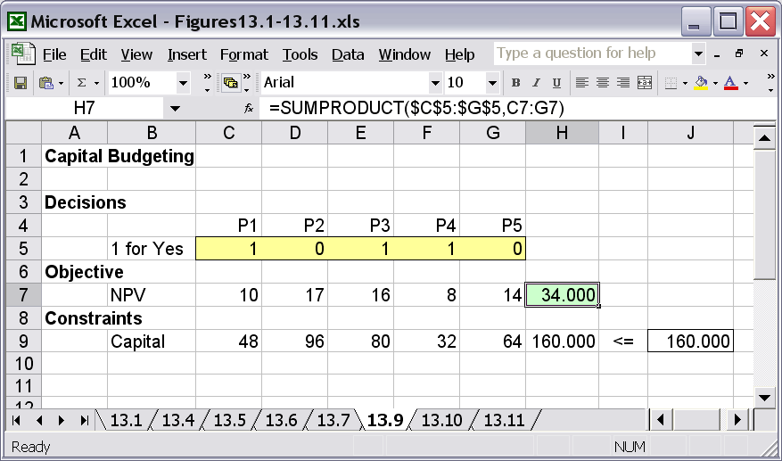
Excel Model

Slide 19
(cont.)
What is the right model?
What is the solution for the LP?
What is the solution for the LP if we add constraints Pi<=1?
Should be modeled as IP with binary variables.
Select P4 five times
Fractional solution: P1, P4, P5, & 20% of P3

Slide 20
Multiple Choice Constraints
Choose exactly one of projects 2 and 5 (both are international projects)
Choose at most one of projects 2 and 5 (require some of the same resources)
Choose at least one of projects 2 and 5
By adding similar constraint, we can select at least m of the projects or at most n of them.
P2 + P5 = 1
P2 + P5 <= 1
P2 + P5 >= 1

Slide 21
Conditional Constraints
If project 5 is chosen, then project 3 must be chosen
If project 3 is chosen, then project 1 or 2 (or both) must be chosen
If project 3 is chosen, then projects 1 and 2 must be chosen
P5 <= P3 (or P3 - P5 >= 0)
P3 <= P1 + P2
2 * P3 <= P1 + P2
(P3 <= P1 & P3 <= P2)

Slide 22
Modeling Tip: Excel Use
The logical functions in Excel (IF, AND, OR, etc.) can express logical relationships
Such functions are nonlinear
Models with IF statements will often stop at local optimum
Using binary variables is the preferred approach

Slide 23
Example: Baseball Problem
The Dodgers are choosing from free-agent pitchers: Rick Sutcliffe (RS), Bruce Sutter (BS), Dennis Eckersley (DE), Steve Trout (ST), or Tim Stoddard (TS).
Data table (next page)
Constraints:
At most $12 million can be spent
At most two right-handed pitchers
Cannot sign both BS and RS
Goal: sign the pitchers to add the most victories

Slide 24
Data
Pitcher | Cost of Signing ($m) | Victories Added to Cubs
RS (righty) | $6 | 6
BS (righty) | $4 | 5
DE (righty) | $3 | 3
ST (lefty) | $2 | 3
TS (righty) | $2 | 2

Slide 25
Math Model
Decision Variables:
RS, BS, DE, ST, TS (binary)
Objective:
max total number of victories =
6RS + 5BS + 3DE + 3ST + 2TS
Constraints:
(Costs) 6RS + 4BS + 3DE + 2ST + 2TS <= 12
(Righty) RS + BS + DE + TS <= 2
(Conflict) RS + BS <= 1

Slide 26
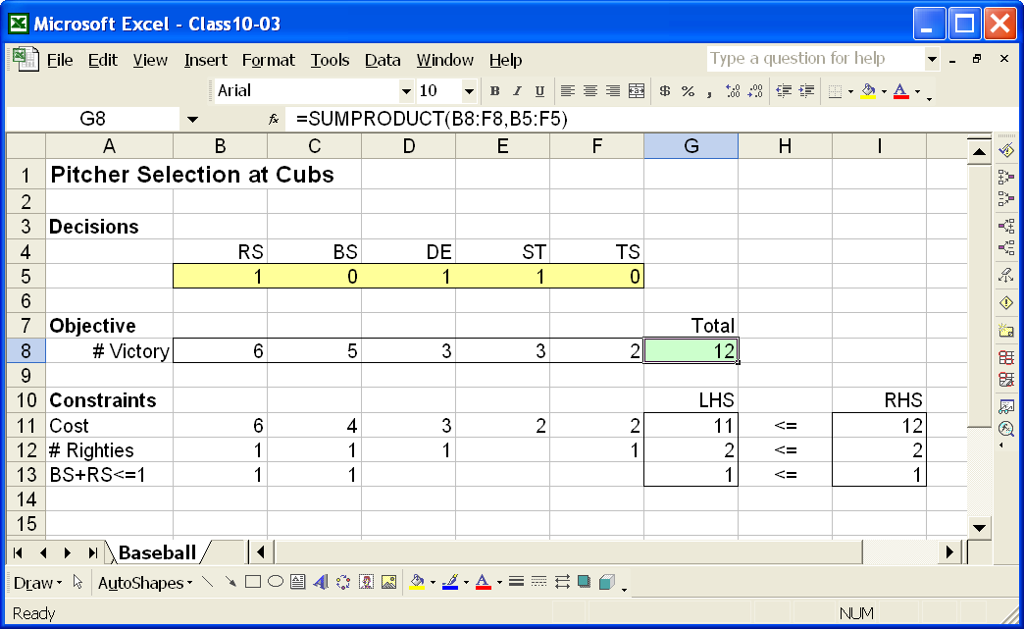
Excel Model

Slide 27
Example: Emergency Coverage (I) p315
The City of Metropolis is divided into nine districts and is considering seven possible sites to place emergency vehicles
The time (minutes) it takes an emergency vehicle to travel from each site to each district is shown in the next table
Find the minimum number of sites so that all districts are within three minutes of an emergency vehicle.

Slide 28
Distance Table
Minutes between Sites and Districts
Sites
 | 1 | 2 | 3 | 4 | 5 | 6 | 7
1
2
3
4
5
6
7
8
9
5 | 3 | 4 | 3 | 8 | 9 | 0
3 | 6 | 5 | 4 | 8 | 0 | 3
4 | 3 | 6 | 8 | 10 | 3 | 2
6 | 0 | 2 | 7 | 3 | 2 | 5
2 | 8 | 2 | 5 | 0 | 6 | 8
2 | 6 | 4 | 0 | 7 | 3 | 5
0 | 12 | 5 | 5 | 5 | 7 | 2
10 | 9 | 0 | 2 | 3 | 5 | 7
2 | 4 | 5 | 7 | 3 | 4 | 5
Districts

Slide 29
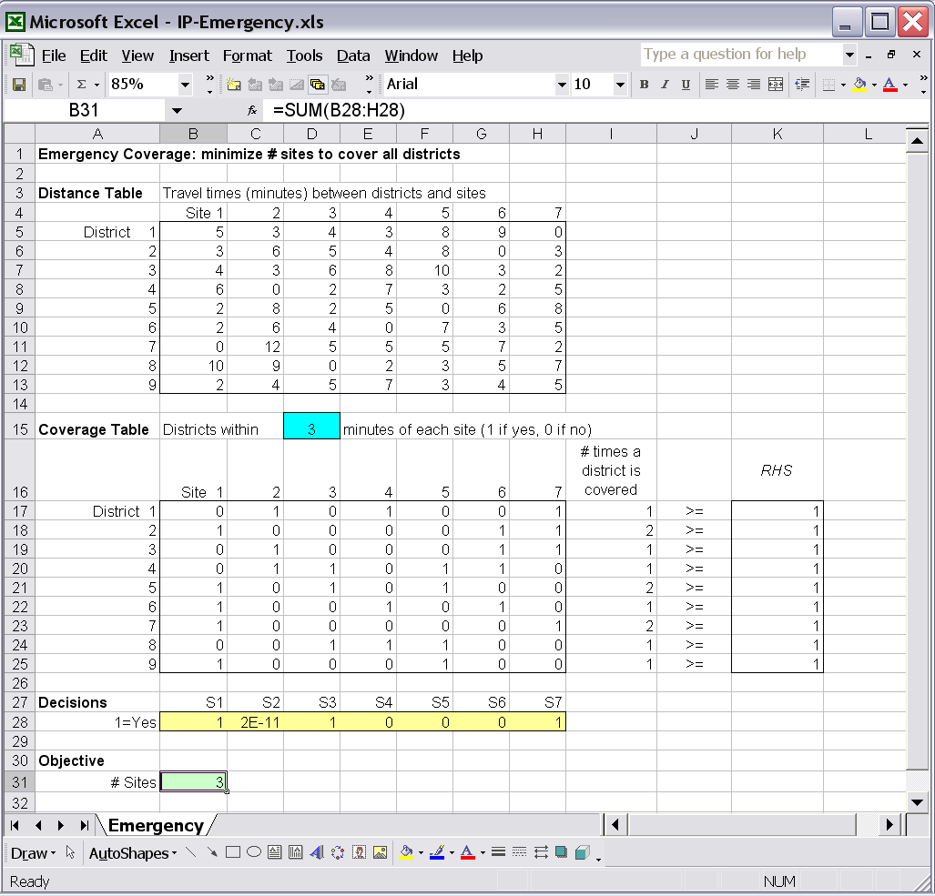
Excel Model

Slide 30
Example: Emergency Coverage (II)
The population of each district (in thousands) is as follows:
Suppose Metropolis has only two emergency vehicles
Decide the locations of the vehicles to maximize the number of people who live within three minutes of an emergency vehicle.
1 | 2 | 3 | 4 | 5 | 6 | 7 | 8 | 9
40 | 30 | 35 | 20 | 15 | 50 | 45 | 60 | 30

Slide 31
Example: Production Mix
Mayhugh Manufacturing Company (p.319)
3 product families
3 departments
If a product is made, a fixed sales cost will be incurred
Tables: Unit profits and hours required
…

Slide 32
(Cont.)
Net Profit =
1.20 x1 + 1.80 x2 + 2.20 x3 - 60 y1 - 200 y2 - 100 y3
Linking constraints:
x1 - M y1 <=0 (can choose M=400)
x2 - M y2 <=0 (can choose M=300)
x3 - M y3 <=0 (can choose M=50)
By choosing M properly, we can combine the demand constraints with the linking constraints

Slide 33
Fixed Costs in General
F – fixed cost
c – per unit cost
x – units of activity (regular variable)
y – go/no go of activity (binary variable)
Cost = Fy + cx (in the objective)
Linking constraint:
x <= My or equivalently, x - My <= 0
M = upper bound on x
If y=0 we must have x =0
If y=1 we have x <=M

Slide 34
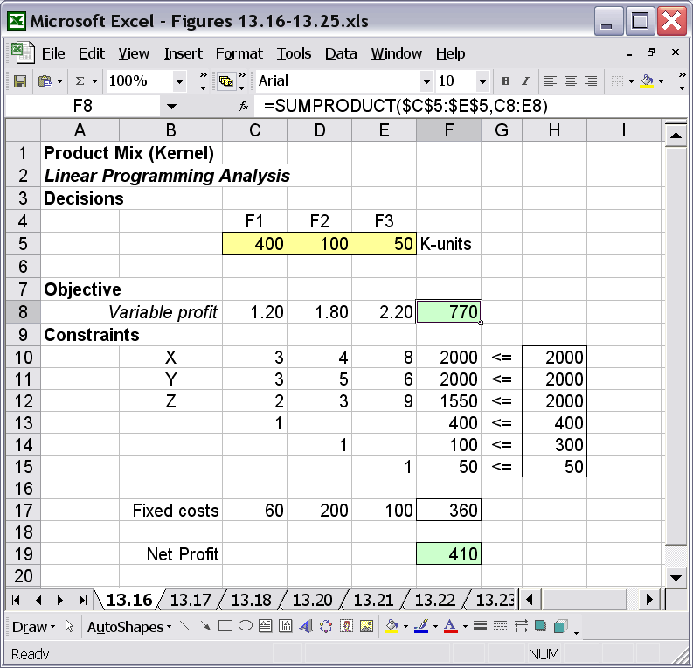
Model without Fixed Costs

Slide 35
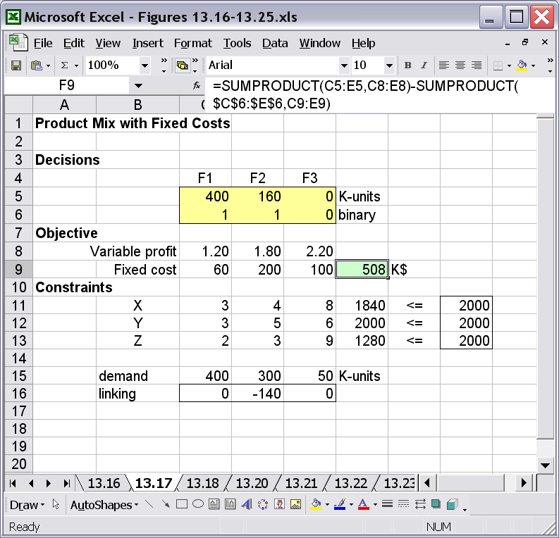
Model with Fixed Costs

Slide 36
Threshold Levels & Quantity Discounts
x – units of activity (regular variable)
m – lower limit of x when x>0
M – upper limit of x when x>0
y – go/no-go of activity (binary variable)
Linking constraints:
x - my >= 0 (lower limit)
and x – My <= 0 (upper limit)
If y=0 we have x>=0 & x<=0 (so x=0)
If y=1 we have x>=m & x<=M (so x is in the desired region)

Slide 37
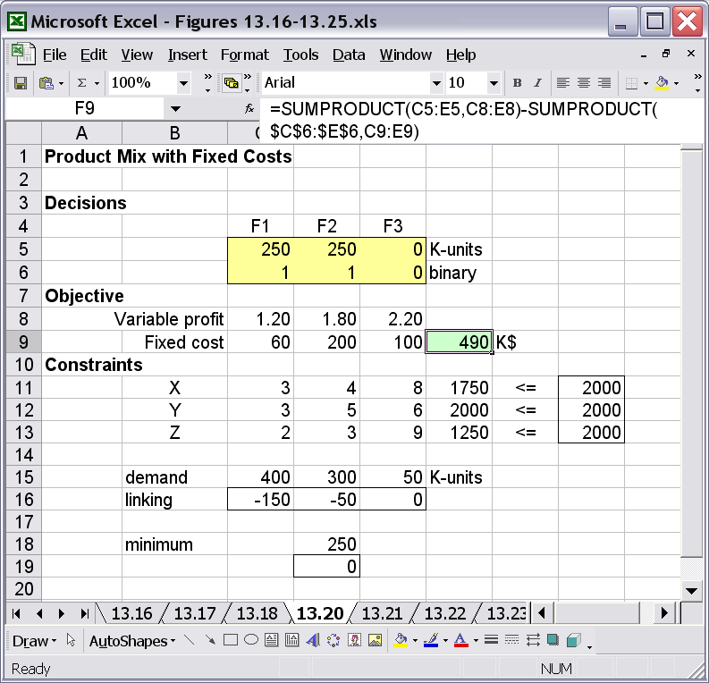
Model with Threshold Constraint
Upper limit (threshold):
X2 – 300*Y2 <= 0
Lower limit (threshold):
X2 – 250*Y2 >= 0

Slide 38
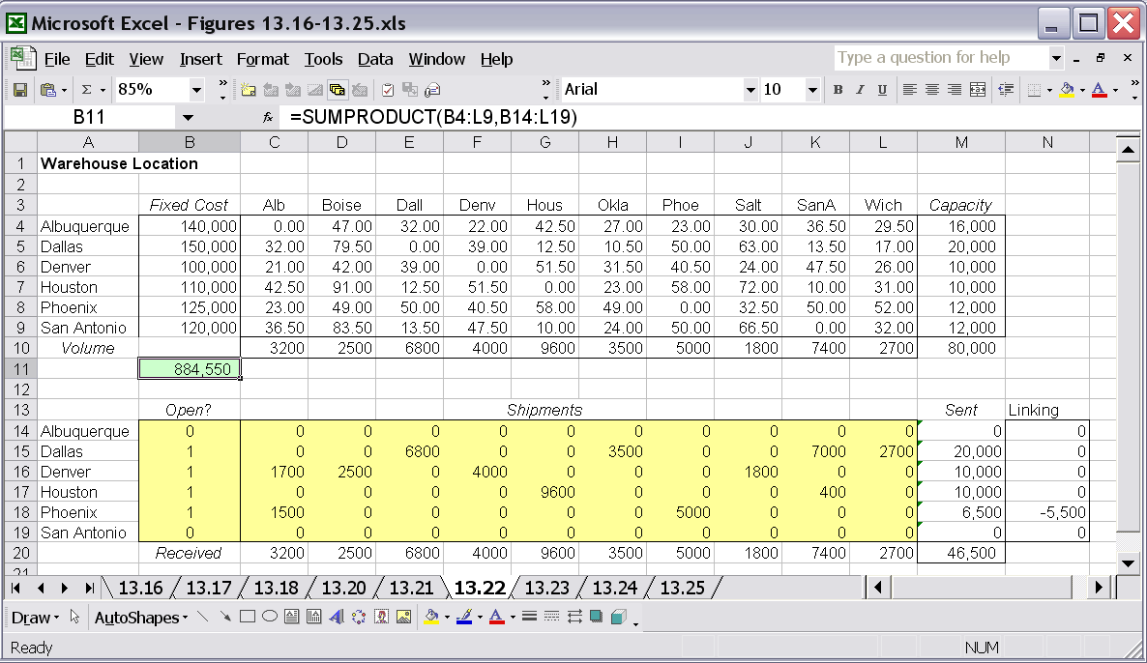
Facility Location: Capacitated (p. 325)
Linking Constraint: Sent - Capacity * Open? <= 0

Slide 39
Model for Fun: The 8-Queen’s Problem
How many queens can you place on the chess board without fighting each other?

